Slide 1
Full Open-Source CI/CD of a dotnet core application
Tech@Agoda
Presented by Cédric Rochefolle
Annop Mungnimit
Patthaphol Kulthawaiporn

Slide 2
Agenda
Definitions
Tools
Application
Build System
Code Coverage
Code Analysis
Hosting

Slide 3
What is CI/CD
Continuous Integration is the practice of integrating all developer codes to a repository several times a day. Every time code is checked-in, an automated build compiles and test the code for early feedback.
Continuous Delivery is a software engineering approach in which teams produce software in short cycles, ensuring that the software can be reliably released at any time. The approach helps reduce the cost, time, and risk of delivering changes by allowing for more incremental updates to applications in production.

Slide 4
Tools
An IDE: VS Code for this demo, but any IDE that supports C# and nodeJS
Git: I will use command line
NodeJs: mostly for the build environment, version 8.x (other version might work)
Yarn (or NPM) 1.7.0 (also tested 1.5.1)
Dotnet core 2.1 (other version should work fine)

Slide 5
Codeshare.io
I will paste links and long content to
https://codeshare.io/TechAtAgoda20180804

Slide 6


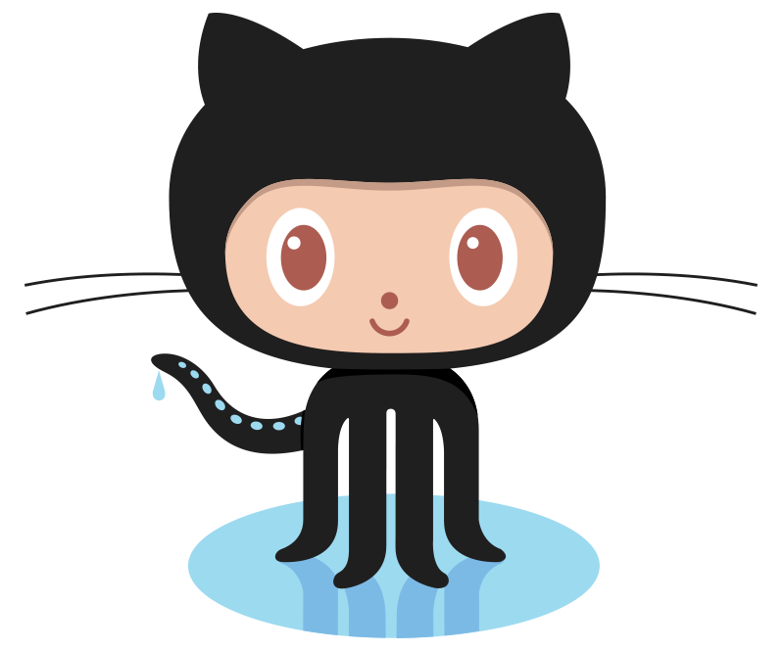





Slide 7
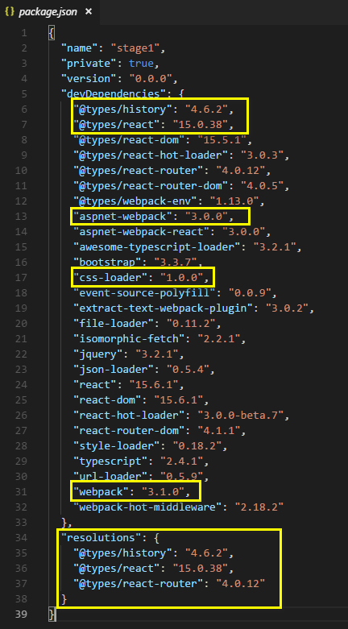
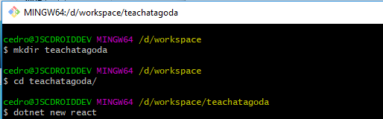
Creating The Application
Now you can run either
‘npm install’ or ‘yarn install’
Delete ‘npm-shrinkwrap.json’ if you use yarn
Do not run ‘npm install’ … not yet

Slide 8
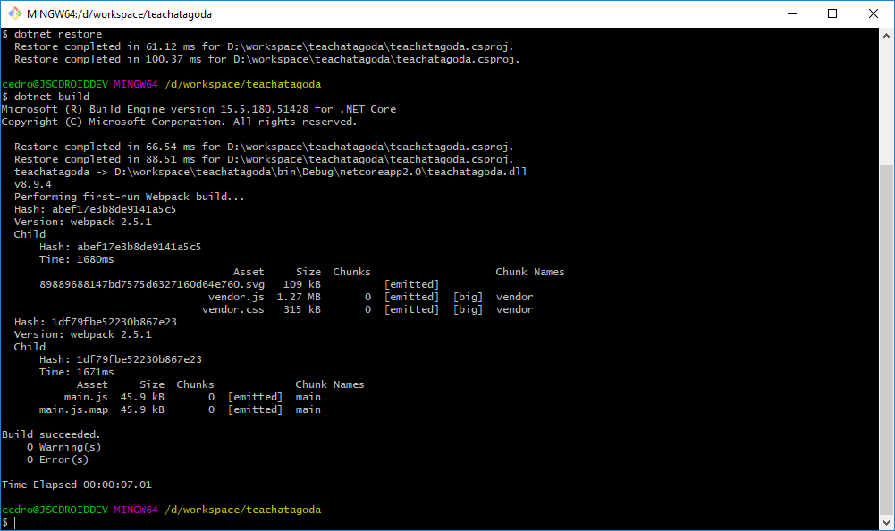
Let’s run it
dotnet restore
dotnet build
ASPNETCORE_ENVIRONMENT=Development dotnet run
Then open a browser on http://localhost:5000

Slide 9
Setup GitHub
Create an account at GitHub (if you don’t already have one)
Create a project in GitHub
Create a SSH key (if you don’t already have one)
Upload your key

Slide 10
Setup Git repository
Initialize a repository
git init
Add assets to the repository
git add .
Verify the content
git status
Commit the source
git commit -m “Initial commit”
Set the remote location
git remote add origin git@github.com:CedricAgoda/techatagoda-cicd.git
“Push” the changes to the remote location on GitHub
git push -u remote master
Setup global variables
git config --global user.name=“Cedric Rochefolle”
git config --global user.email=“cedric.rochefolle@agoda.com”
Or use private email in GitHub

Slide 11
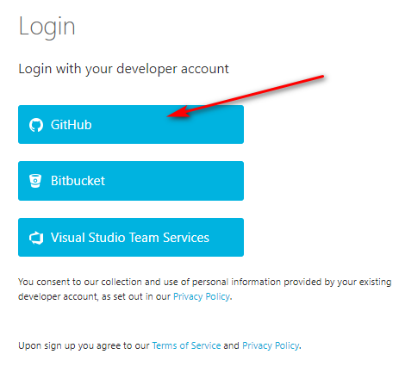
Appveyor
Go to appveyor.com
Go to the “Sign-in” link
Use the “GitHub” link
Click the “New Project” link
Select the GitHub link
Authorize GitHub
Click on your project

Slide 12
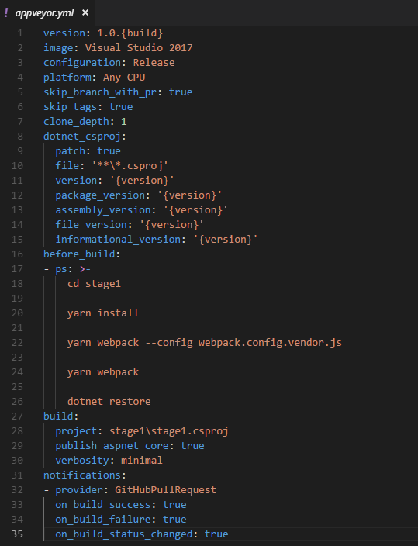
Save the YAML

Slide 13
Let’s add Unit Tests
Create a new folder at same level
cd ..
mkdir tests
cd tests
dotnet new xunit
Add reference to the project (use your .csproj path)
dotnet add reference ../src/stage1.csproj
dotnet restore

Slide 14
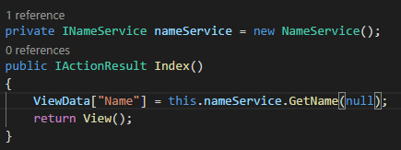
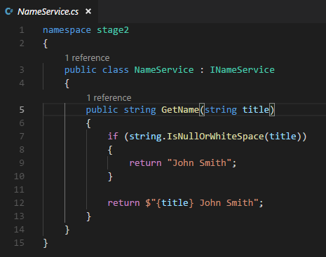
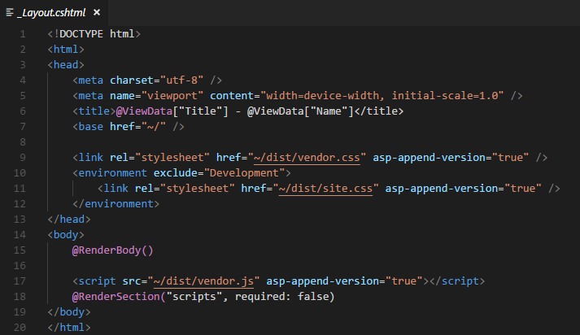
Create a dummy Service

Slide 15
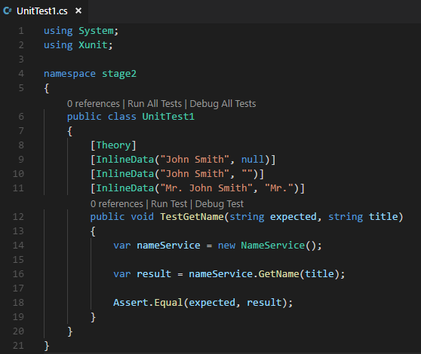
Add Unit Test

Slide 16
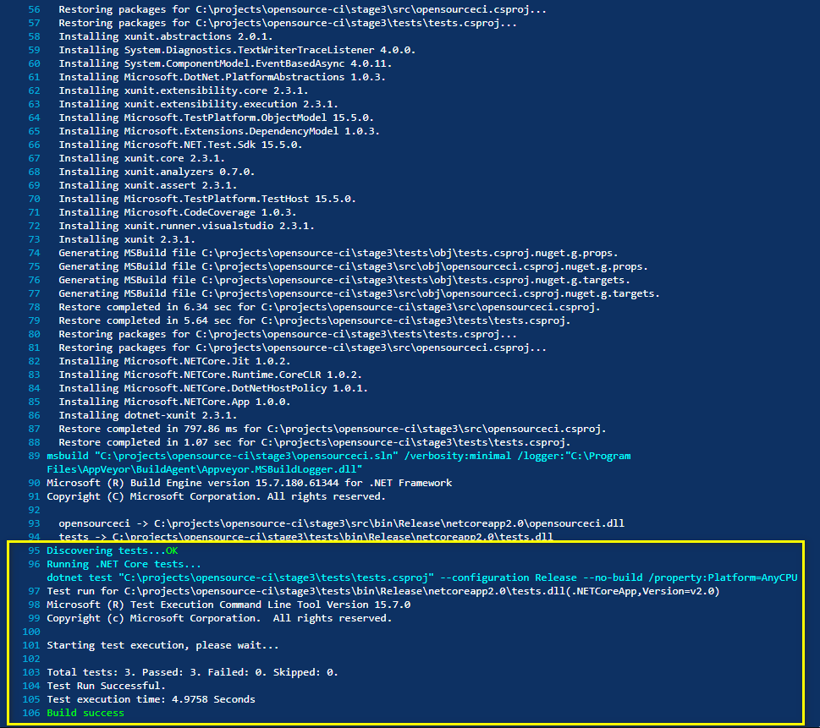
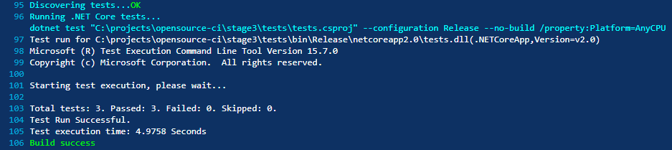
Run tests in CI

Slide 17
Let’s add Code Coverage
Opencover parameters:
register: to register the code coverage (the OS will not let you inspect DLL if this setting is not correct). In our case, use “-register:user”
oldStyle: used for pre-Silverlight code. It also helps to inspect dotnet core code ☺
target: what command to execute
targetargs: the parameters to run the above command
filter: to include/exclude code to cover (namespace names, supports wildcard)
output: the XML to output that can be sent to reporting
Add opencover dependency
dotnet add package opencover
dotnet restore
Find the local nuget folder
dotnet nuget locals -l global-packages
Run opencover
& $HOME\.nuget\packages\opencover\4.6.519\tools\OpenCover.Console.exe -register:user -oldStyle -target:"dotnet.exe" -targetargs:"test tests.csproj" -filter:"+[opensourceci*]* +[tests*]*" -output:"coverage.xml"

Slide 18
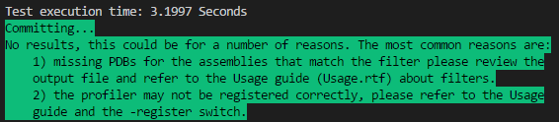
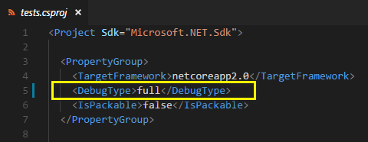
But… it doesn’t work ☹
We need to add “FULL” debug mode in both application and test projects:

Slide 19
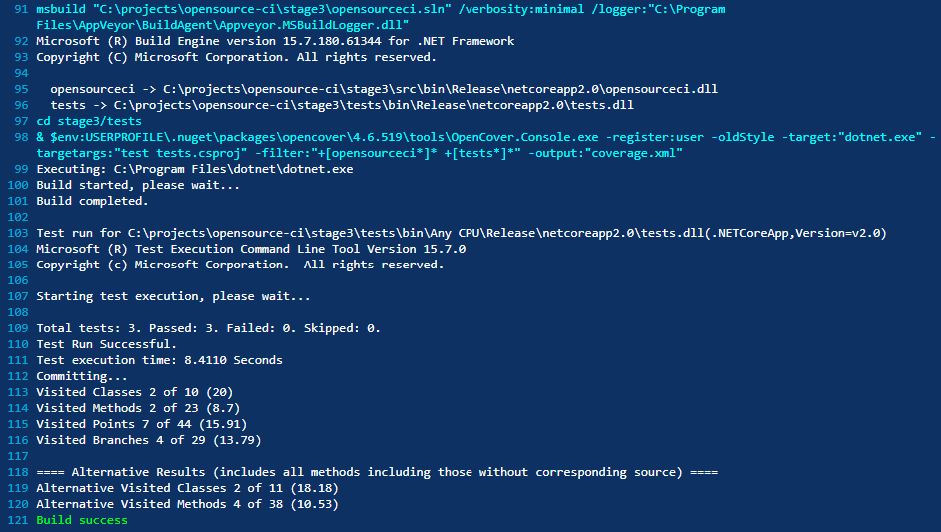
Let’s run this in the CI
Why build again???
We can add “--no-build” to the “targetargs”
-targetargs:"test --no-build tests.csproj"

Slide 20
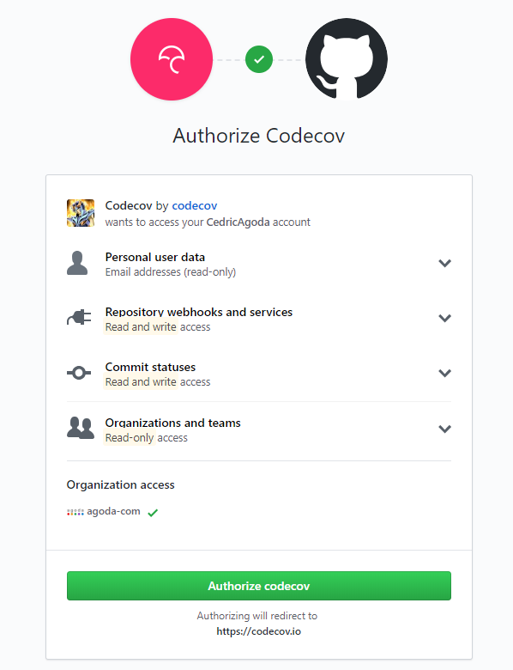
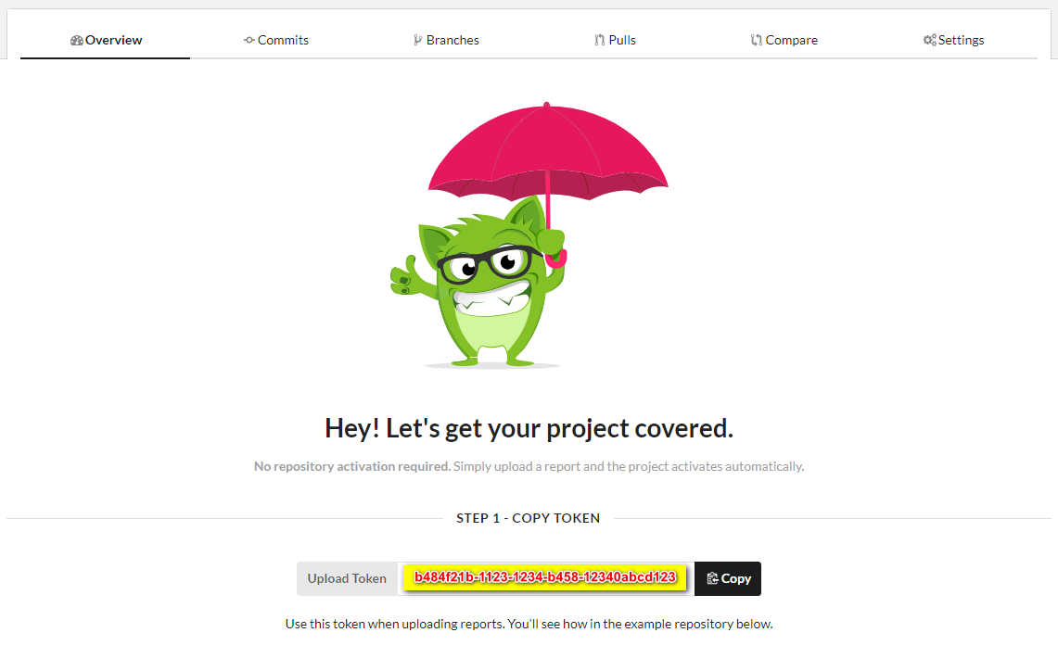
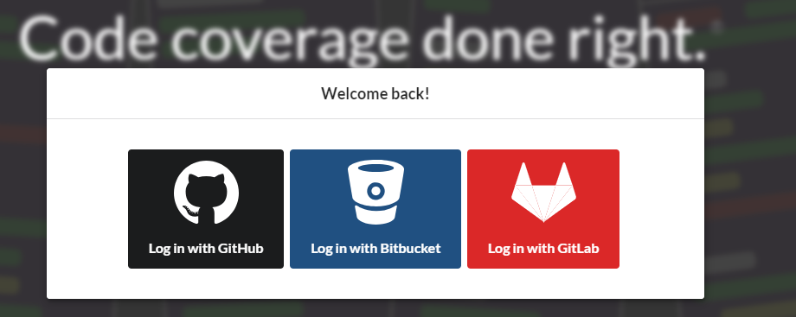
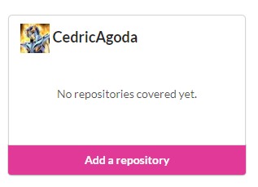
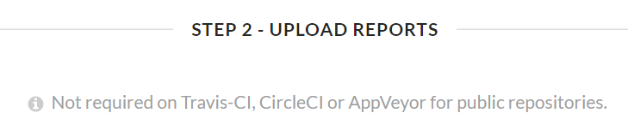
Pushing code coverage to CodeCov
Go to https://codecov.io
Click on Sign-in

Slide 21
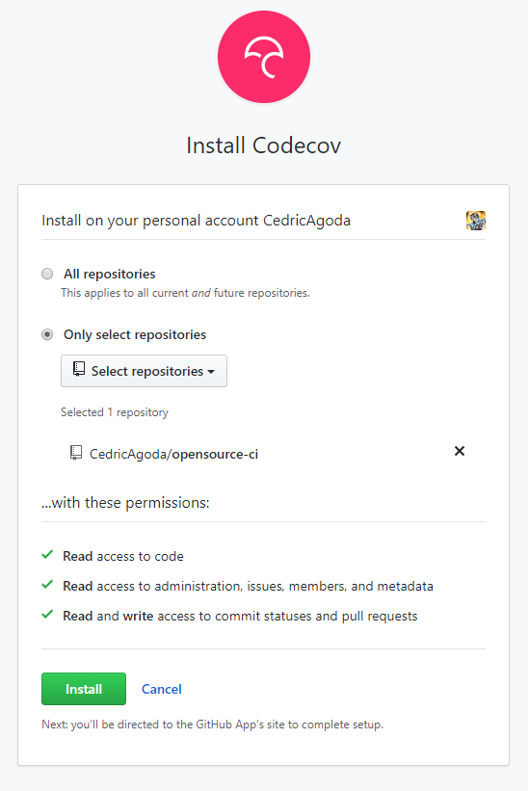
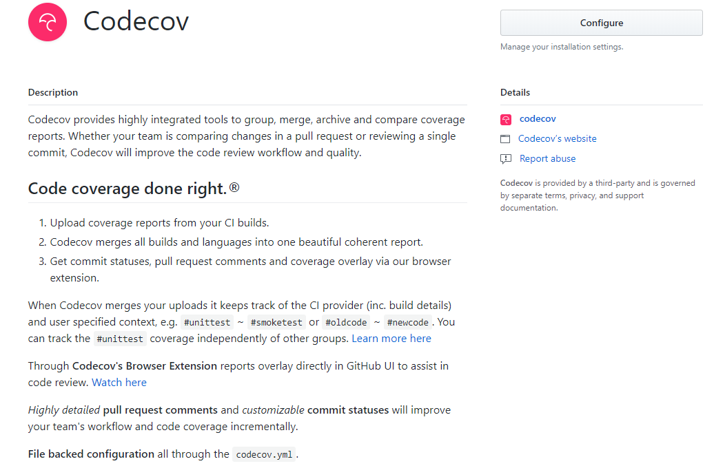
Authorize Codecov in github

Slide 22
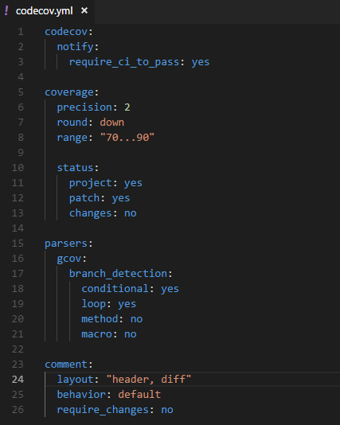
Create a YAML for Codecov

Slide 23
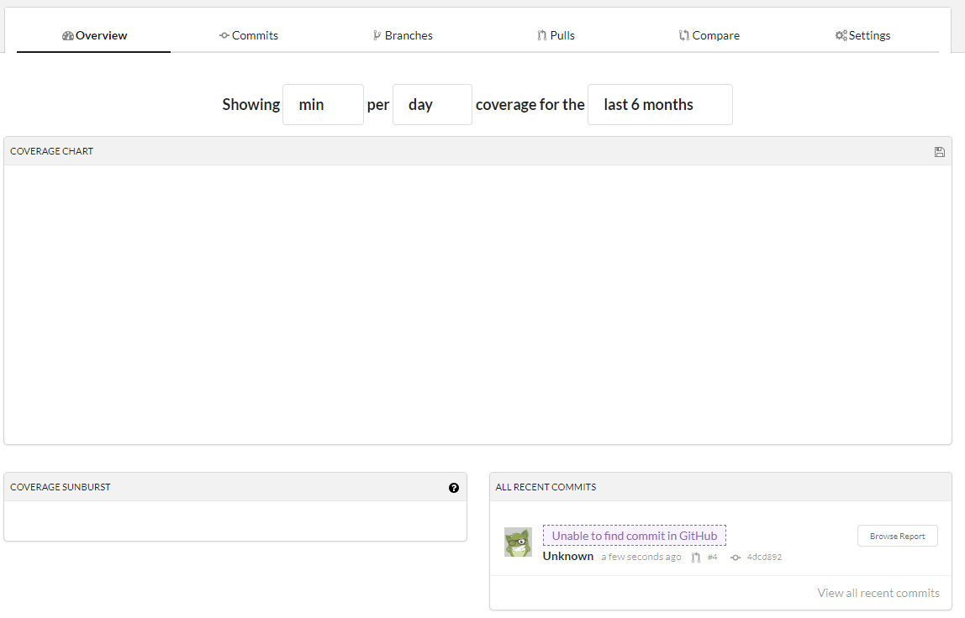
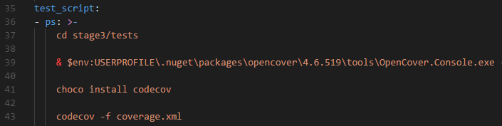
Run the codecov plugin
After successful build and push to the PR, you will need to push to the master (or default) branch for codecov to be properly indexing things

Slide 24
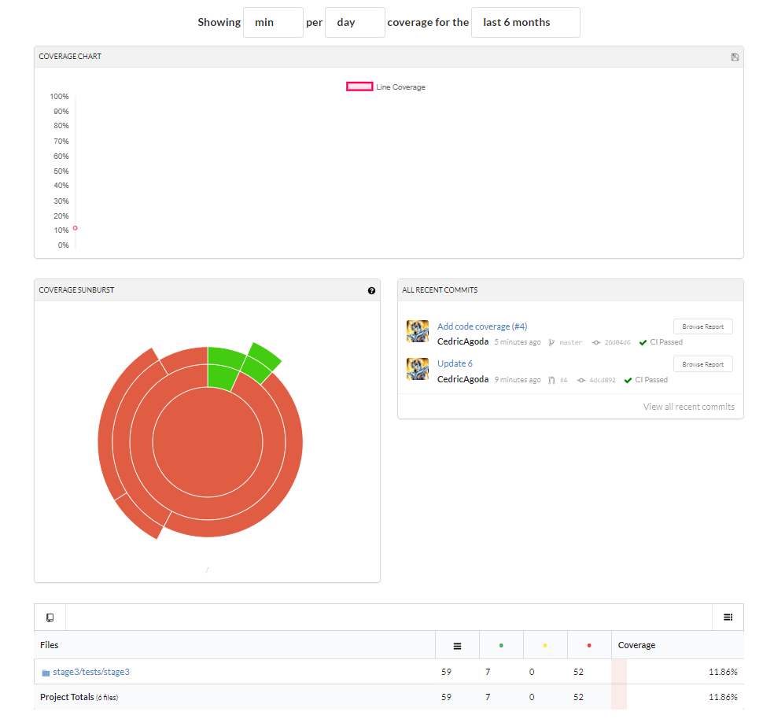
Codecov dashboard

Slide 25
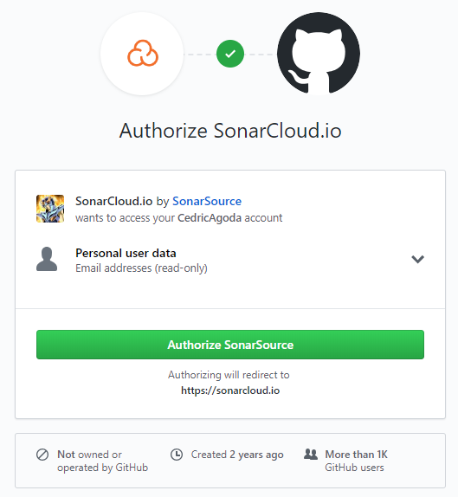
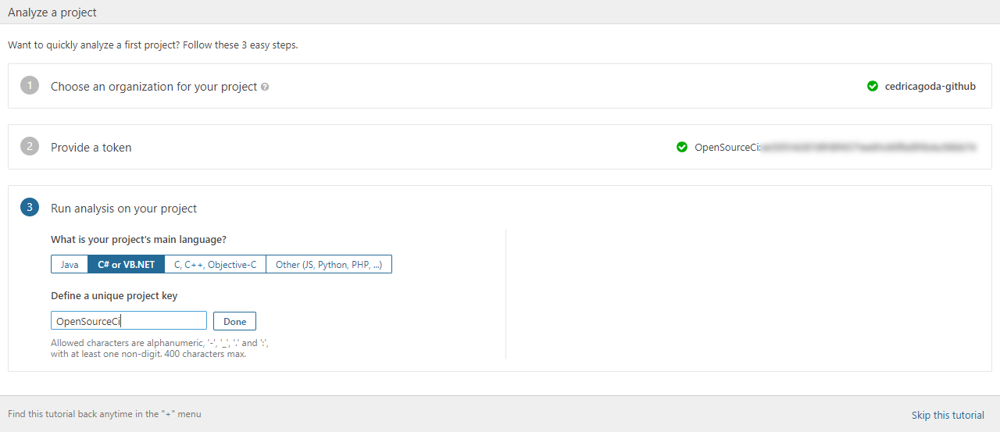
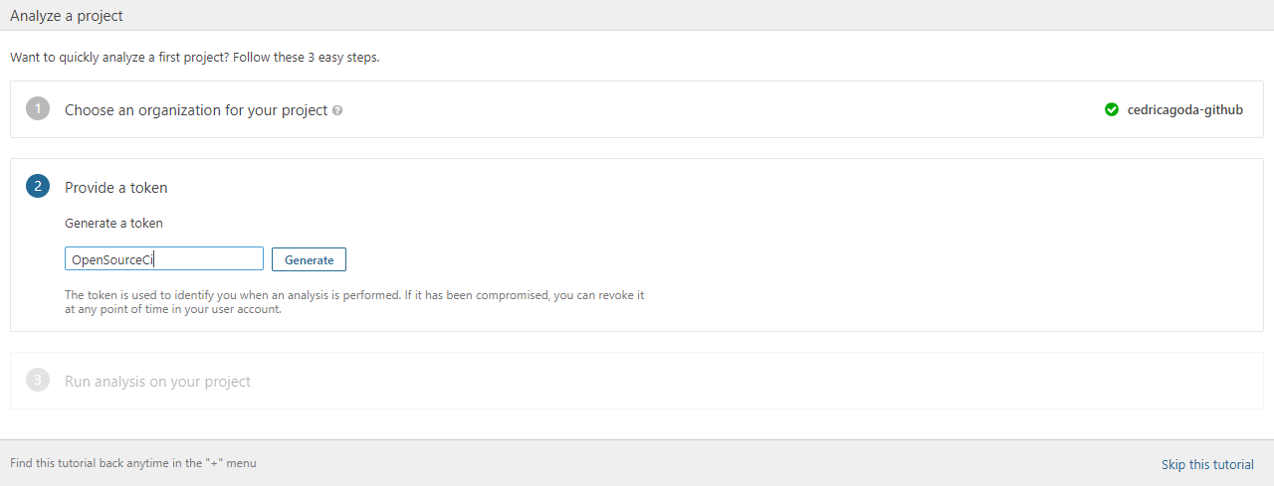
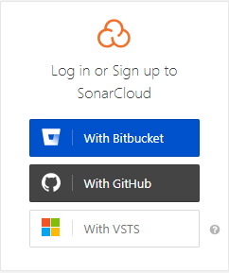
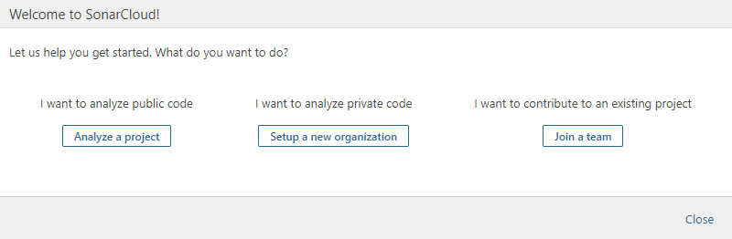
Let’s add Static Code Analysis
Got to https://sonarcloud.io
Click on “Log-In”

Slide 26
Aww…
We need to download the SonarScanner for MSBuild
We’ll add the download in the before_build step
Add in the appveyor.yml file
choco install --no-progress sonarscanner-msbuild-netcoreapp2.0

Slide 27
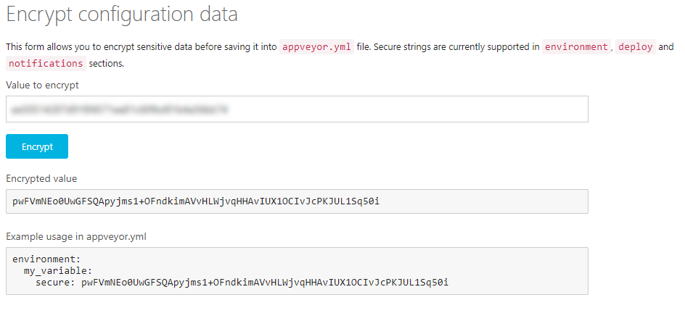
Creating a Secret Key
Go to https://ci.appveyor.com/tools/encrypt

Slide 28
SonarQube configuration
Add in the appveyor.yml file
environment:
SonarScannerMsBuild: sonar-scanner-msbuild-4.3.1.1372-netcoreapp2.0.zip
SonarExclusions: coverage\**\*,**\*.xml,**\*.js,tscoverage\**\*,**\jestsetup.ts,**\*.ico,**\Program.cs,**\Startup.cs
SonarKey:
secure: pwFVmNEo0UwGFSQApyjms1+OFndkimAVvHLWjvqHHAvIUX1OCIvJcPKJUL1Sq50i
------------------------
dotnet "$env:APPVEYOR_BUILD_FOLDER\sonar-scanner-msbuild\SonarScanner.MSBuild.dll" begin /k:opensource-ci /v:$env:APPVEYOR_BUILD_VERSION /d:sonar.organization=cedricagoda-github /d:sonar.host.url="https://sonarcloud.io" /d:sonar.cs.opencover.reportsPaths="coverage.xml" /d:sonar.login="$env:SonarKey" /d:sonar.exclusions="$env:SonarExclusions"

Slide 29
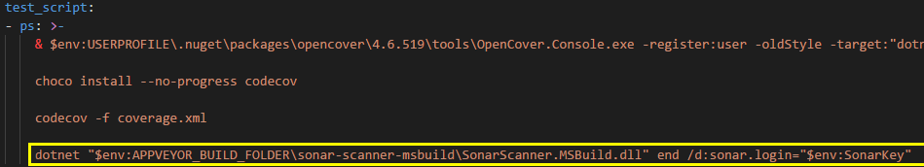
More configuration

Slide 30
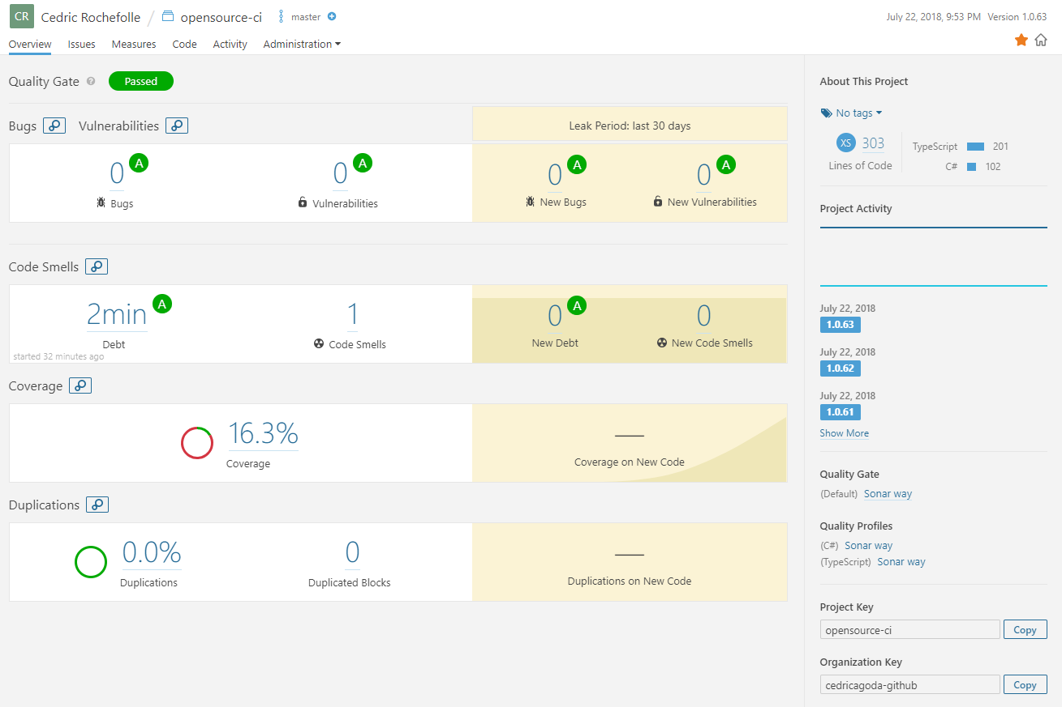
Let’s see in SonarCloud

Slide 31
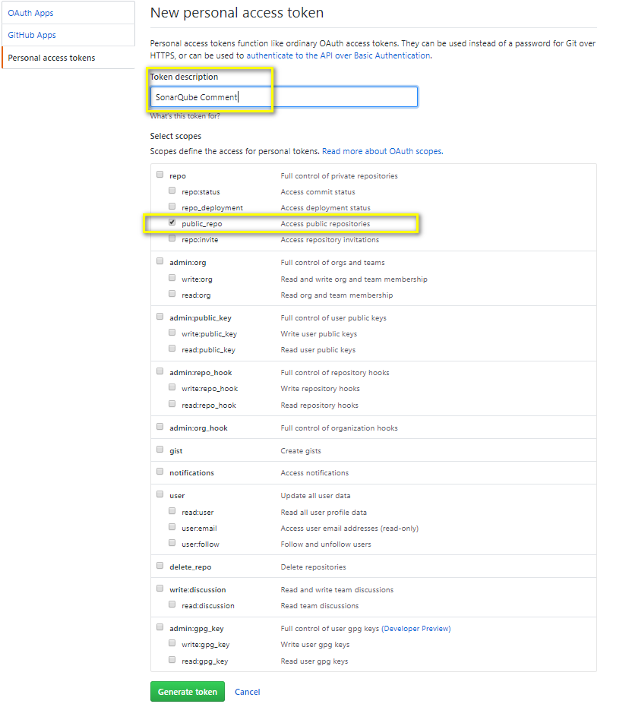
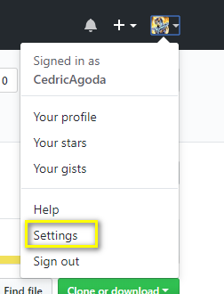
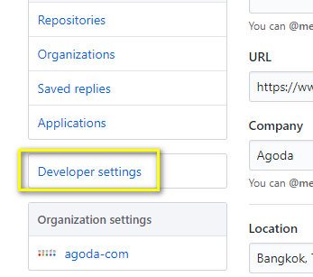
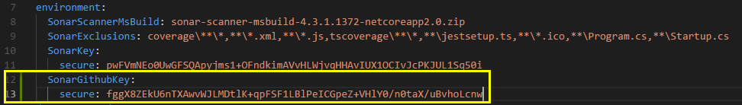
Let’s add SQ postback to github

Slide 32
And let’s report back
For pull requests, we can report back to GitHub and block a merge
We can add an ‘if’ statement and if it is a PR we can add to the ‘begin’ command
We can add some mistake to see the effect.
/d:sonar.analysis.mode=preview /d:sonar.github.pullRequest=$env:APPVEYOR_PULL_REQUEST_NUMBER /d:sonar.github.repository=$env:APPVEYOR_REPO_NAME /d:sonar.github.oauth=$env:SonarGithubKey

Slide 33
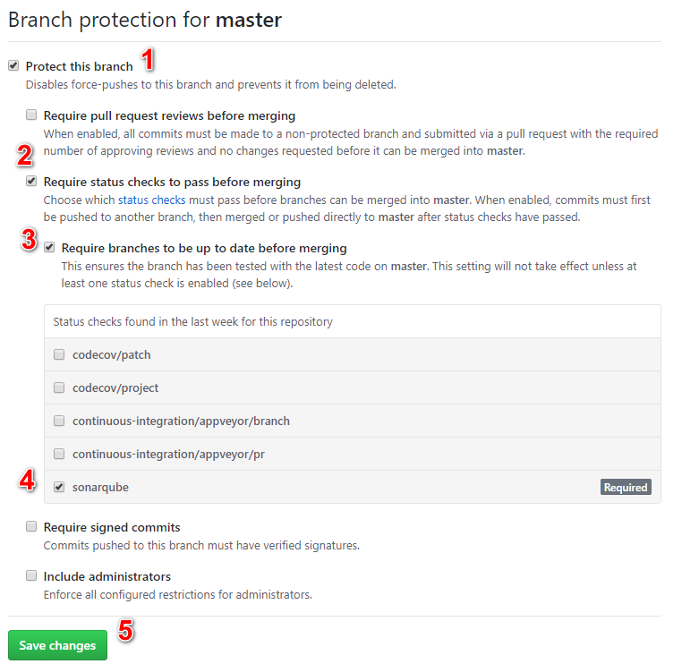
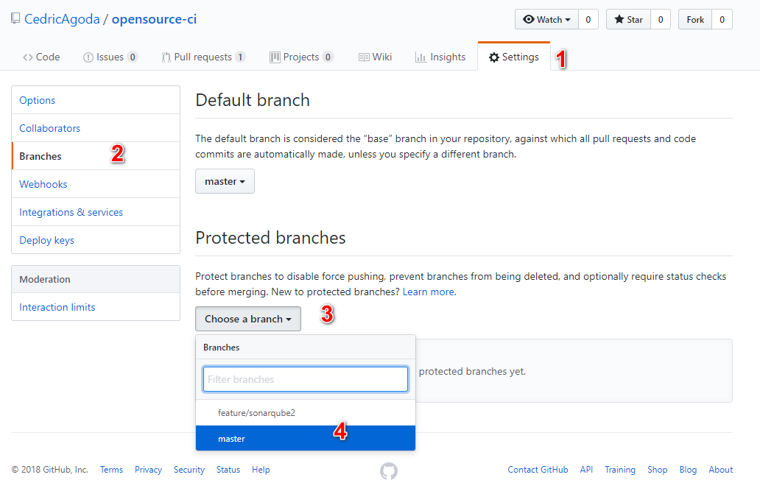
Let’s protected the branch
In order to prevent bad code to be merged to your master branch, you can protect it
To do so you add “required” statuses (remember the custom statuses in AppVeyor?)

Slide 34
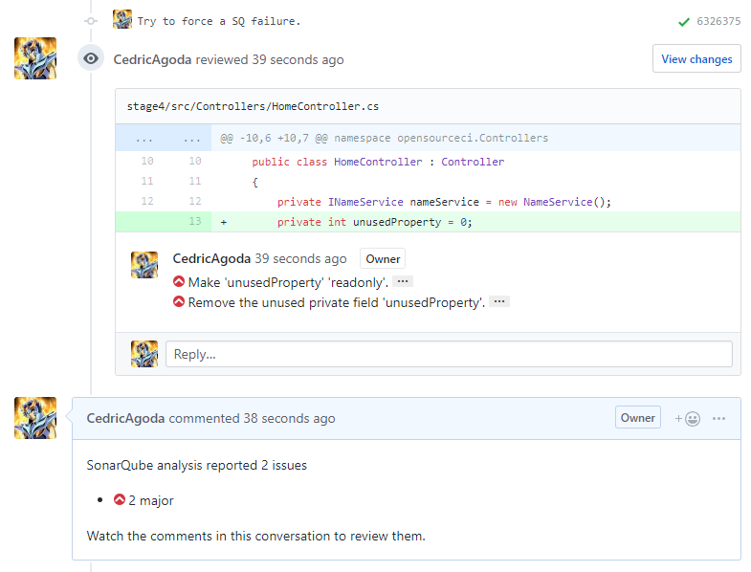
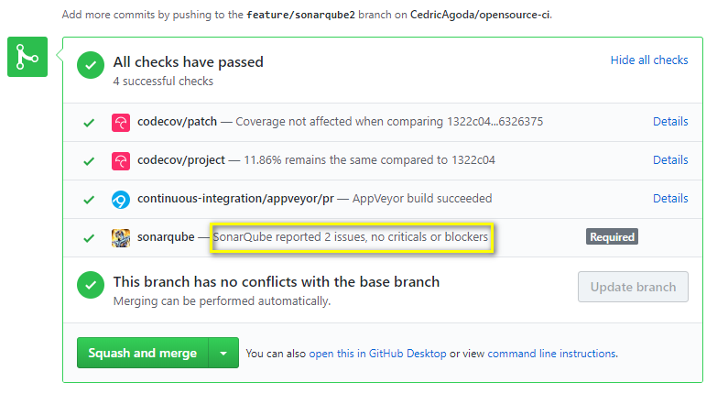
Result of non-blocking errors

Slide 35
Let’s be code-nazi ☺
Quality Profile:
We can define in SonarQube what rules to enable or disable
We can also define the level of an issue
Quality Gate:
We can define what are the threshold to consider a code version to pass or not the level of quality we define. Examples:
Fail if < 40% code coverage
Fail if > 2 days of technical debt

Slide 36
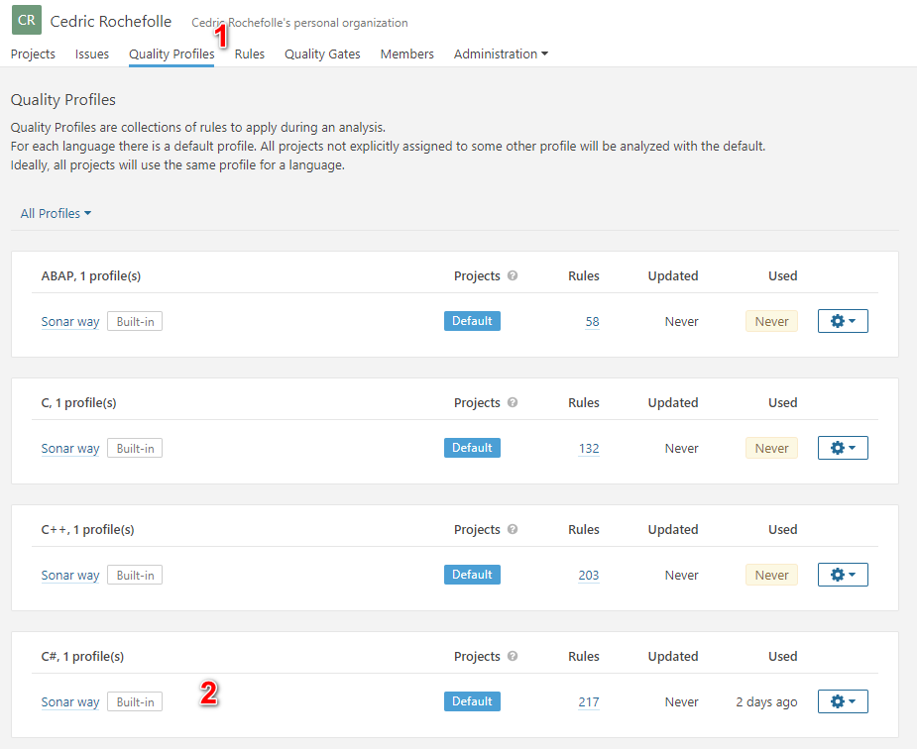
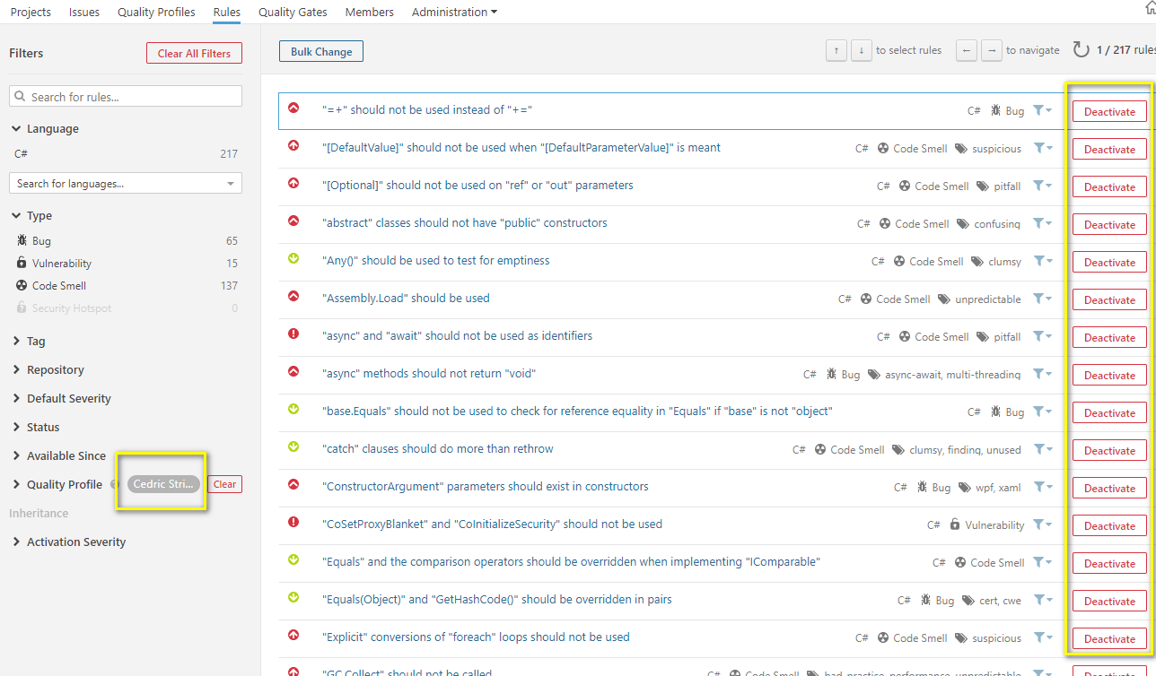
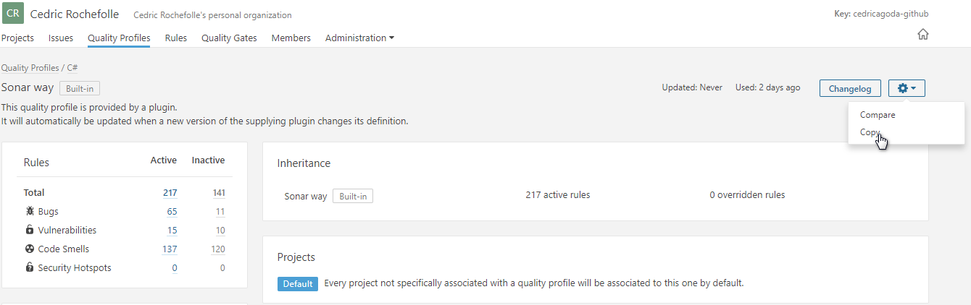
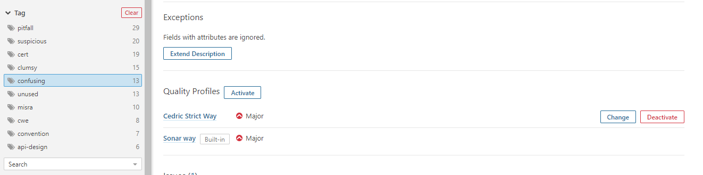
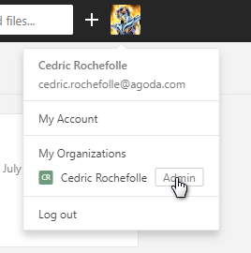
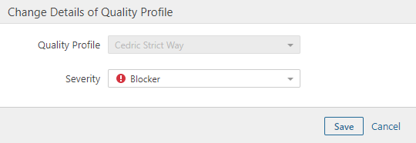
How to change SonarQube rules and levels

Slide 37
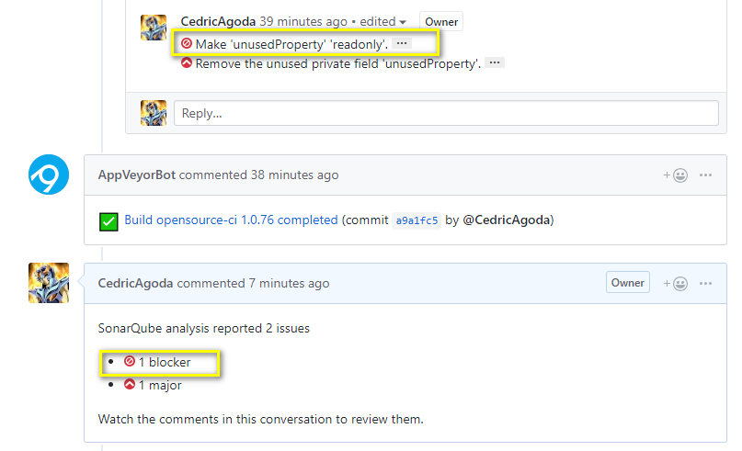
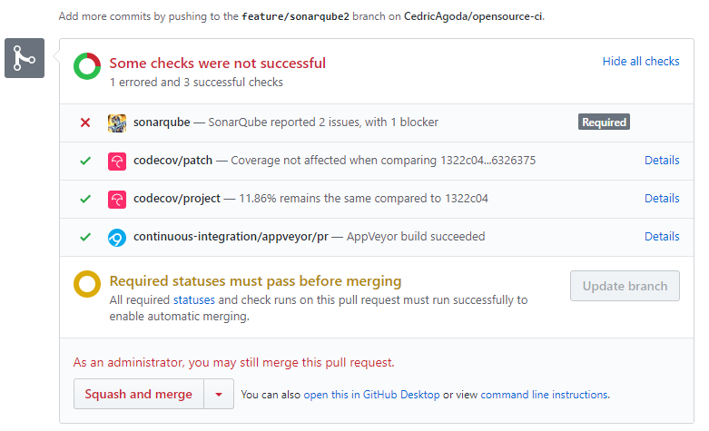
Kaboom!
Fix the code and push to clear the issue

Slide 38

Now to the hosting!
Go to https://portal.azure.com
Click “Create a resource”
Search for “App service Plan”
Then click “Create”

Slide 39


Where is the beer?
Enter the plan name and resource group
Select “Windows” for operating system
Click on “Pricing tier” and select “F1” in the “Dev/Test” section
Click “Apply”
Click “Create” in the resource section

Slide 40



Now to create the instance
Click on “Create a resource” →”Web” → “Web App”
Enter a name
Choose the previously created “Resource Group”
Select “Windows” as operating system
Click “App Service plan/Location” and select the previously created plan
If you don’t do that, it will create automatically a new non-free one
Click ”Create”

Slide 41

We need credentials
Browse to your App Service
Click on “Deployment credentials”
Enter a username and password (+confirm)
Click the “Save” icon at the top

Slide 42

Application Dashboard

Slide 43



Update AppVeyor.yml
Encrypt the azure password you created
Don’t create a PR: AppVeyor doesn’t deploy on Pull Requests
If you need to, there is a deployment setting you can use

Slide 44


Let’s see our application

Slide 45
Recap
Created a dotnet core + react application using CLI scaffolding
Added it to GitHub
Added an automated build on Appveyor
Added code analysis and coverage
Published code stats to SonarCloud and CodeCov
Created a free tier environment in Azure
Deployed to Azure!

Slide 46
Thank You
Questions and Answers?
Agoda is hiring: https://careersatagoda.com/departments/technology/

Slide 47
Links and credits
GitHub: https://github.com
Appveyor: https://appveyor.com
Codecov: https://codecov.io
SonarCloud: https://sonarcloud.io
Opencover: https://github.com/opencover/opencover/wiki/Usage
Azure Portal: https://portal.azure.com/

